Slide 1
Conformal Boundary States for free boson
Hassaan Saleem

Slide 2
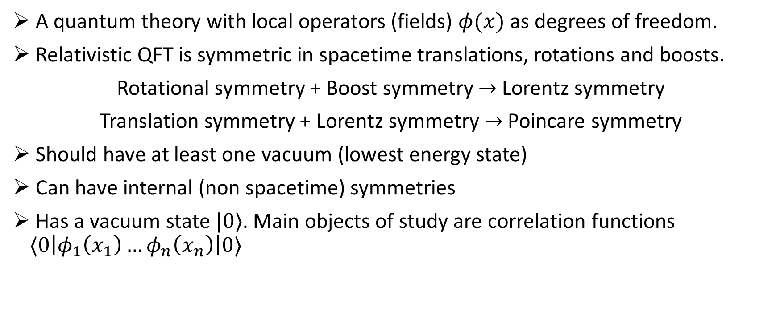
What is Quantum Field Theory (QFT)?
A quantum theory with local operators (fields) $φ(x)$ as degrees of freedom.
Relativistic QFT is symmetric in spacetime translations, rotations and boosts.
Rotational symmetry + Boost symmetry $→$Lorentz symmetry
Translation symmetry + Lorentz symmetry$→$ Poincare symmetry
Should have at least one vacuum (lowest energy state)
Can have internal (non spacetime) symmetries
Has a vacuum state $|0⟩$. Main objects of study are correlation functions $⟨0\left|φ_{1}\left(x_{1}\right)…φ_{n}\left(x_{n}\right)\right|0⟩$

Slide 3
Why study Conformal Field Theory (CFT)?
CFTs can be made very rigorous.
Fixed Points in RG flow.
Extensive use in condensed matter physics (phase transitions and behaviour near criticality).
Super String Theory is a (super) conformal theory.

Slide 4
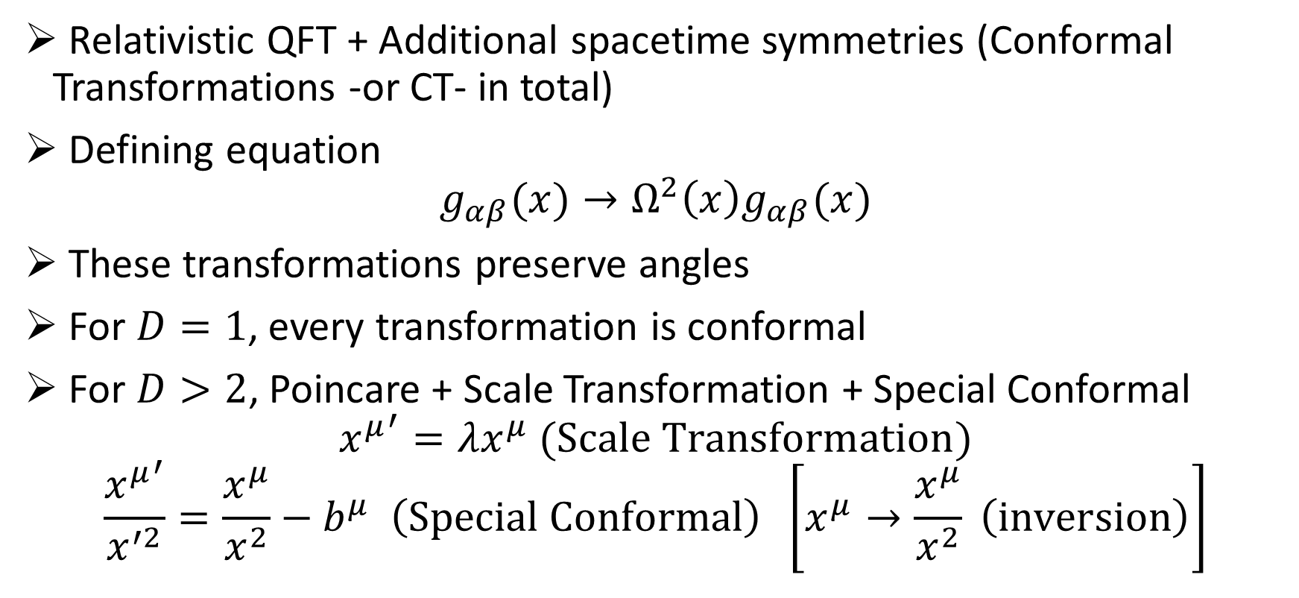
What is CFT?
Relativistic QFT + Additional spacetime symmetries (Conformal Transformations -or CT- in total)
Defining equation
$$g_{αβ}(x)→Ω^{2}\left(x\right)g_{αβ}(x)$$
These transformations preserve angles
For $D=1$, every transformation is conformal
For $D>2$, Poincare + Scale Transformation + Special Conformal
$${x^{μ}}^{′}=λx^{μ} (Scale Transformation)$$
$$\frac{{x^{μ}}^{′}}{x^{′2}}=\frac{x^{μ}}{x^{2}}−b^{μ} \left(Special Conformal\right) \left[x^{μ}→\frac{x^{μ}}{x^{2}} \left(inversion\right)\right]$$

Slide 5
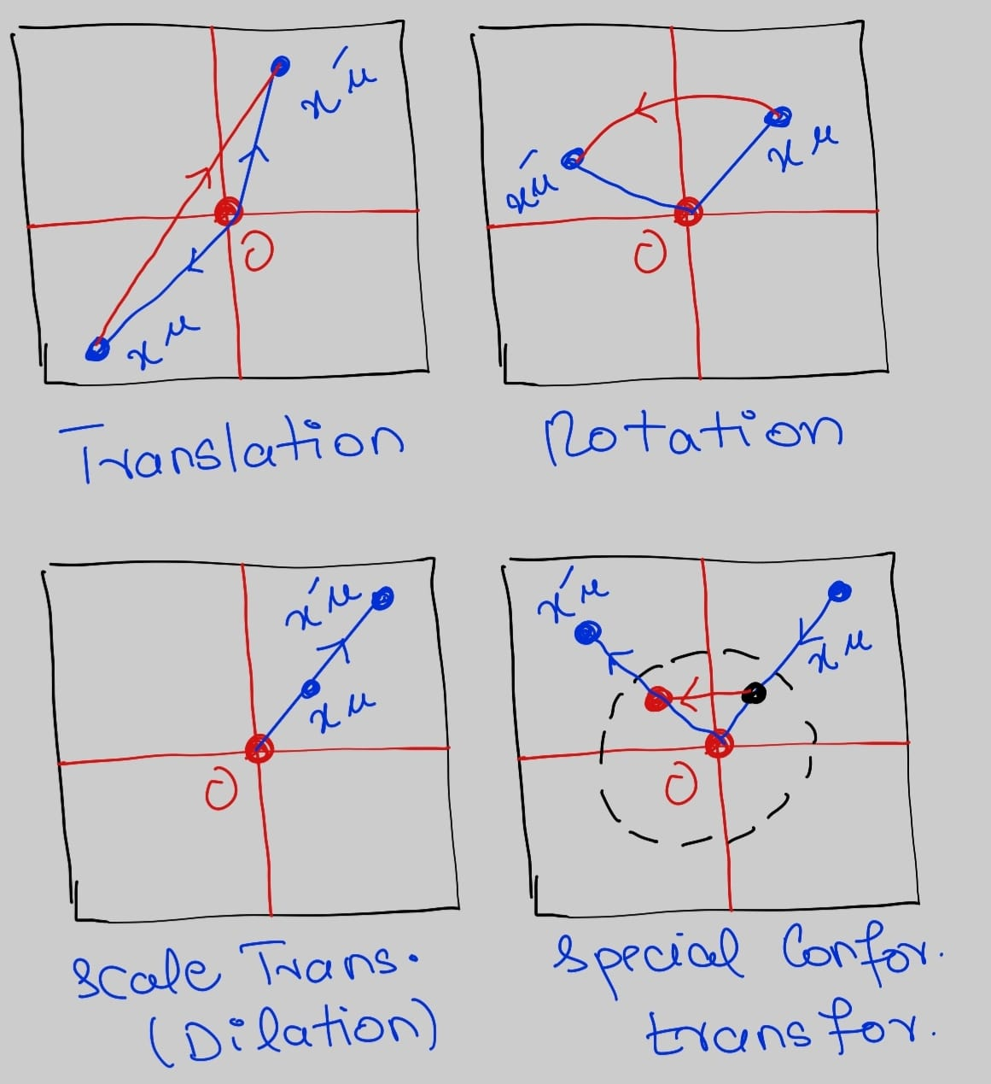

Conformal Transformations for $D>2$

Slide 6
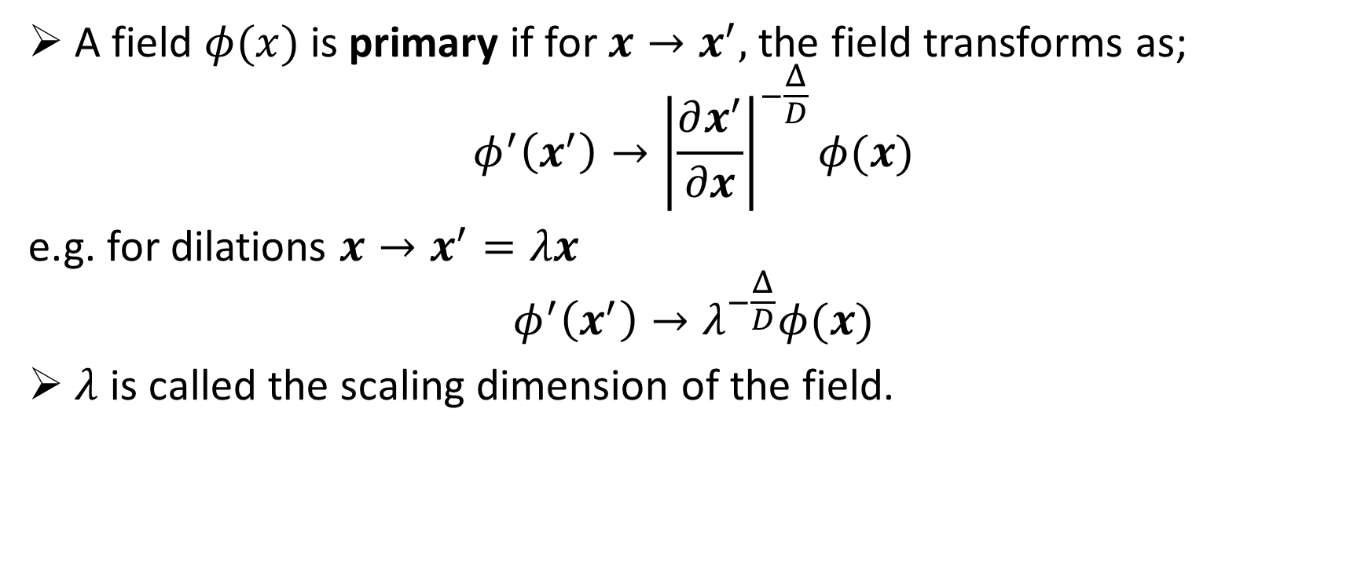
Primary Fields
A field $φ(x)$ is primary if for $x→x^{′},$ the field transforms as;
$$φ^{′}\left(x^{′}\right)→{\left|\frac{∂x^{′}}{∂x}\right|}^{−\frac{Δ}{D}}φ(x)$$
e.g. for dilations $x→x^{′}=λx$
$$φ^{′}\left(x^{′}\right)→λ^{−\frac{Δ}{D}}φ(x)$$
$λ$ is called the scaling dimension of the field.

Slide 7
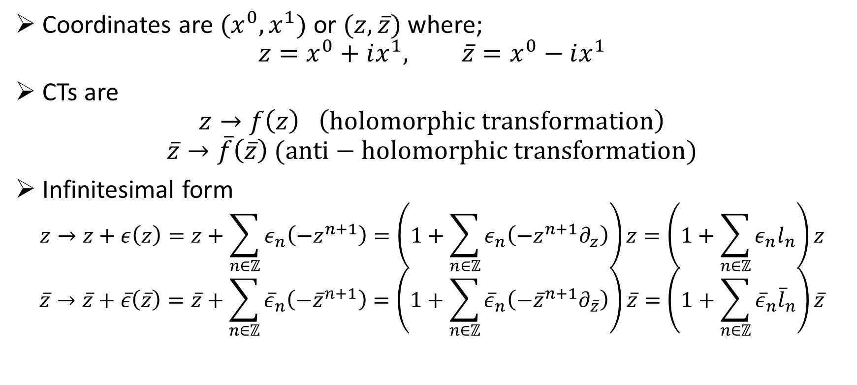
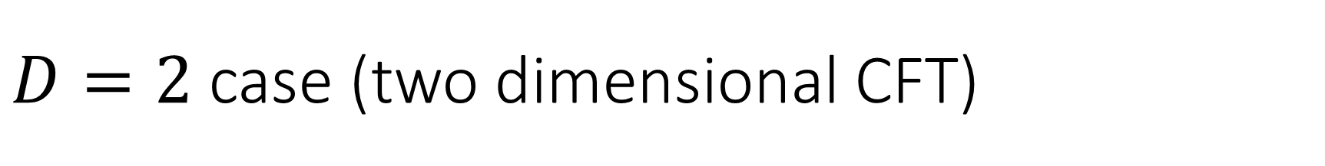
$D=2$ case (two dimensional CFT)
Coordinates are ${(x}^{0},x^{1})$ or $(z,\overline{z})$ where;
$$z=x^{0}+ix^{1}, \overline{z}=x^{0}−ix^{1}$$
CTs are
$$z→f\left(z\right) \left(holomorphic transformation\right)$$
$$\overline{z}→\overline{f}\left(\overline{z}\right) (anti−holomorphic transformation)$$
Infinitesimal form
$$z→z+ε\left(z\right)=z+\sum_{n∈ℤ}{ε_{n}\left(−z^{n+1}\right)}=\left(1+\sum_{n∈ℤ}{ε_{n}\left(−z^{n+1}∂_{z}\right)}\right)z=\left(1+\sum_{n∈ℤ}{ε_{n}l_{n}}\right)z$$
$$\overline{z}→\overline{z}+\overline{ε}\left(\overline{z}\right)=\overline{z}+\sum_{n∈ℤ}{{\overline{ε}}_{n}\left(−{\overline{z}}^{n+1}\right)}=\left(1+\sum_{n∈ℤ}{{\overline{ε}}_{n}\left(−{\overline{z}}^{n+1}∂_{\overline{z}}\right)}\right)\overline{z}=\left(1+\sum_{n∈ℤ}{{\overline{ε}}_{n}{\overline{l}}_{n}}\right)\overline{z}$$

Slide 8
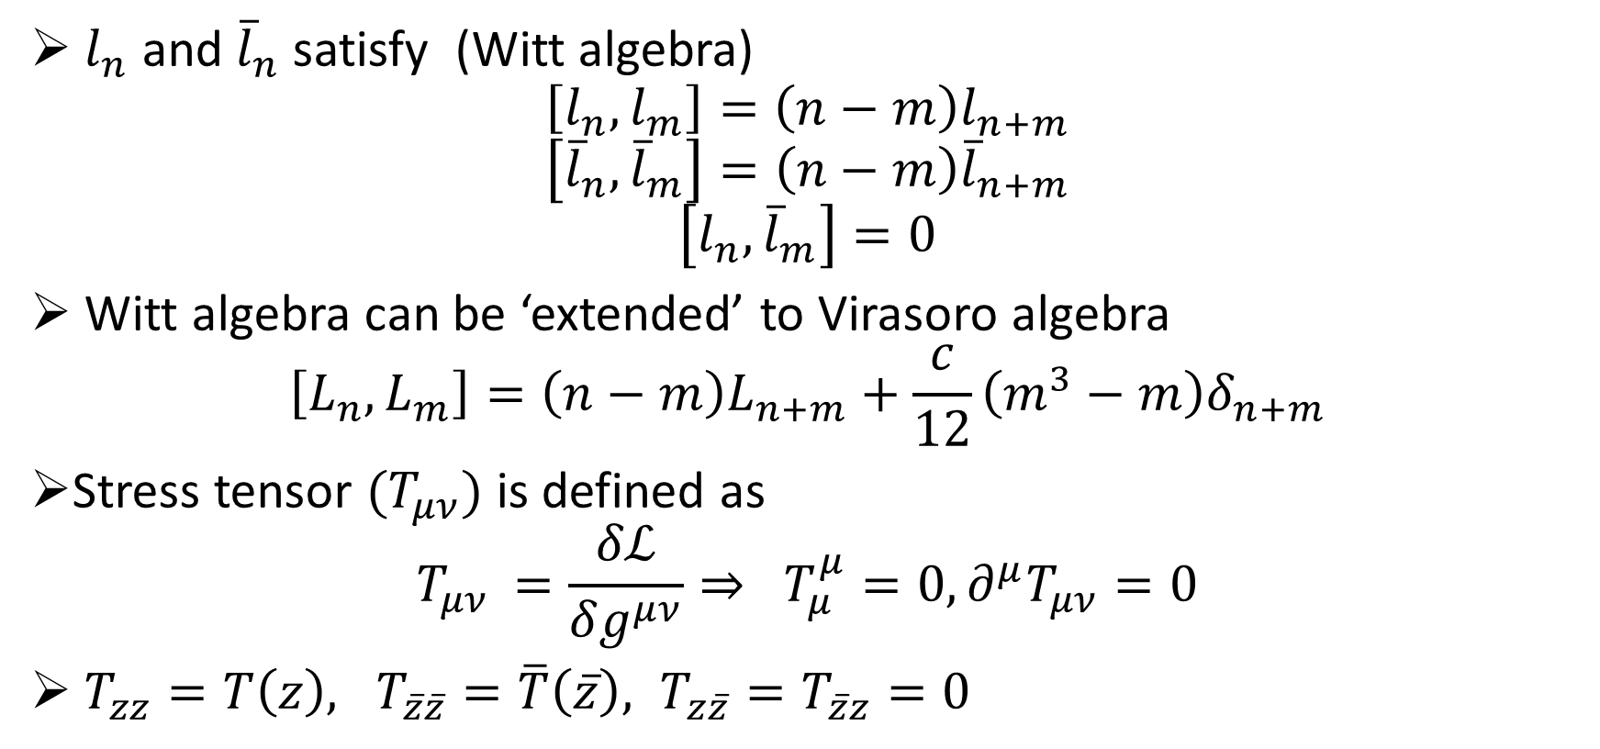
Virasoro Algebra and Stress tensor
$l_{n}$ and ${\overline{l}}_{n}$ satisfy (Witt algebra)
$$\left[l_{n},l_{m}\right]=\left(n−m\right)l_{n+m}$$
$$\left[{\overline{l}}_{n},{\overline{l}}_{m}\right]=\left(n−m\right){\overline{l}}_{n+m}$$
$$\left[l_{n},{\overline{l}}_{m}\right]=0$$
Witt algebra can be ‘extended’ to Virasoro algebra
$$\left[L_{n},L_{m}\right]=\left(n−m\right)L_{n+m}+\frac{c}{12}\left(m^{3}−m\right)δ_{n+m}$$
Stress tensor $(T_{μν})$ is defined as
$$T_{μν }=\frac{δℒ}{δg^{μν}}⇒ T_{μ}^{μ}=0, ∂^{μ}T_{μν}=0$$
$T_{zz}=T\left(z\right), T_{\overline{z}\overline{z}}=\overline{T}\left(\overline{z}\right), T_{z\overline{z}}=T_{\overline{z}z}=0$

Slide 9
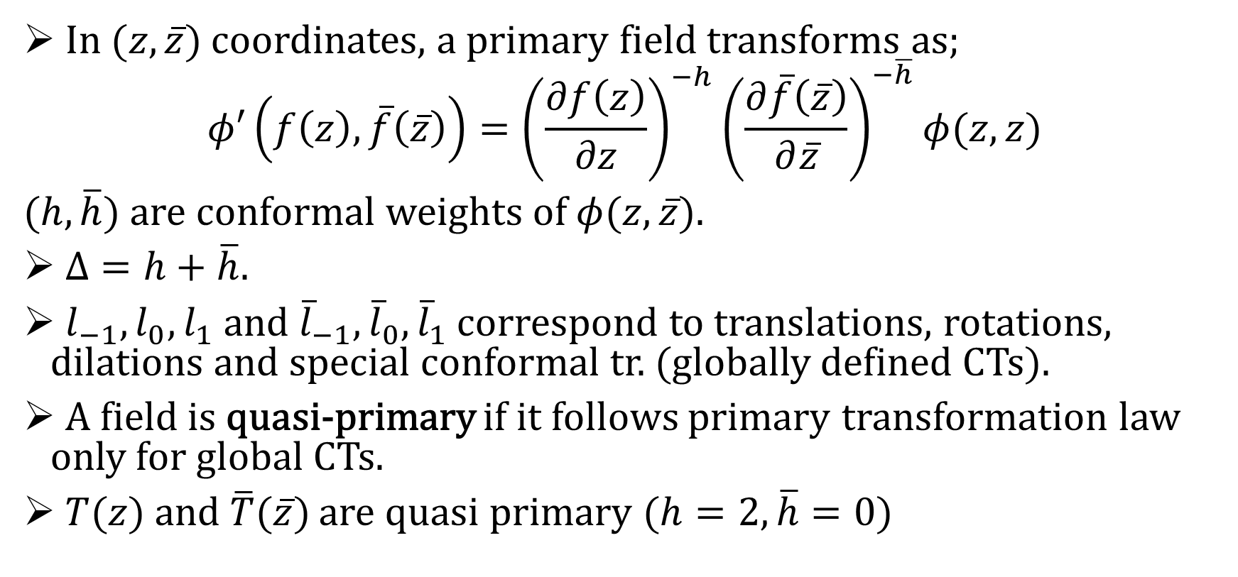

Primary field in $D=2$ CFT
In $(z,\overline{z})$ coordinates, a primary field transforms as;
$$φ′\left(f\left(z\right),\overline{f}\left(\overline{z}\right)\right)={\left(\frac{∂f\left(z\right)}{∂z}\right)}^{−h}{\left(\frac{∂\overline{f}\left(\overline{z}\right)}{∂\overline{z}}\right)}^{−\overline{h}}φ(z,z)$$
$(h,\overline{h})$ are conformal weights of $φ(z,\overline{z})$.
$Δ=h+\overline{h}$.
$l_{−1},l_{0},l_{1}$ and ${\overline{l}}_{−1},{\overline{l}}_{0},{\overline{l}}_{1}$ correspond to translations, rotations, dilations and special conformal tr. (globally defined CTs).
A field is quasi-primary if it follows primary transformation law only for global CTs.
$T(z)$ and $\overline{T}(\overline{z})$ are quasi primary $(h=2, \overline{h}=0)$

Slide 10
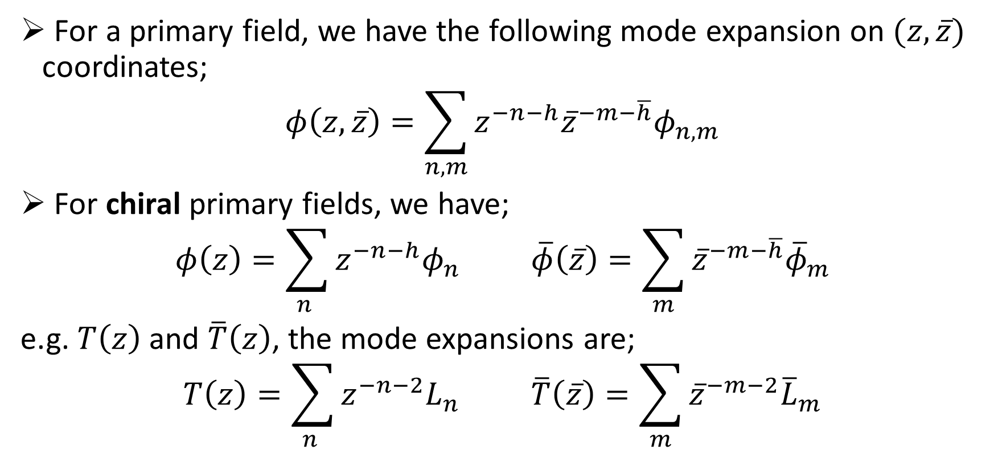
Mode expansions
For a primary field, we have the following mode expansion on $(z,\overline{z})$ coordinates;
$$φ\left(z,\overline{z}\right)=\sum_{n,m}{z^{−n−h}{\overline{z}}^{−m−\overline{h}}φ_{n,m}}$$
For chiral primary fields, we have;
$$φ\left(z\right)=\sum_{n }{z^{−n−h}φ_{n}} \overline{φ}\left(\overline{z}\right)=\sum_{m}{{\overline{z}}^{−m−\overline{h}}{\overline{φ}}_{m}}$$
e.g. $T\left(z\right)$ and $\overline{T}\left(z\right)$, the mode expansions are;
$$T\left(z\right)=\sum_{n }{z^{−n−2}L_{n}} \overline{T}\left(\overline{z}\right)=\sum_{m}{{\overline{z}}^{−m−2}{\overline{L}}_{m}}$$

Slide 11
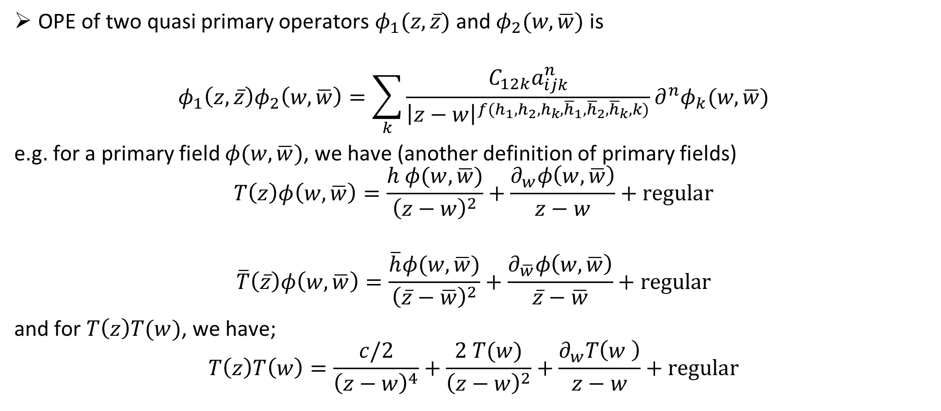
Operator Product Expansion (OPE)
OPE of two quasi primary operators $φ_{1}(z,\overline{z})$ and $φ_{2}(w,\overline{w})$ is
$$φ_{1}\left(z,\overline{z}\right)φ_{2}\left(w,\overline{w}\right)=\sum_{k}{\frac{C_{12k}a_{ijk}^{n}}{{\left|z−w\right|}^{f(h_{1},h_{2},h_{k},{\overline{h}}_{1},{\overline{h}}_{2},{\overline{h}}_{k},k)}}{∂^{n}φ}_{k}(w,\overline{w})}$$
e.g. for a primary field $φ(w,\overline{w})$, we have (another definition of primary fields)
$$T\left(z\right)φ\left(w,\overline{w}\right)=\frac{h φ(w,\overline{w})}{{\left(z−w\right)}^{2}}+\frac{∂_{w}φ\left(w,\overline{w}\right)}{z−w}+regular$$
$$\overline{T}\left(\overline{z}\right)φ\left(w,\overline{w}\right)=\frac{\overline{h}φ(w,\overline{w})}{{\left(\overline{z}−\overline{w}\right)}^{2}}+\frac{∂_{\overline{w}}φ\left(w,\overline{w}\right)}{\overline{z}−\overline{w}}+regular$$
and for $T\left(z\right)T(w)$, we have;
$$T\left(z\right)T\left(w\right)=\frac{c/2}{{\left(z−w\right)}^{4}}+\frac{2 T(w)}{{\left(z−w\right)}^{2}}+\frac{∂_{w}T\left(w \right)}{z−w}+regular$$

Slide 12
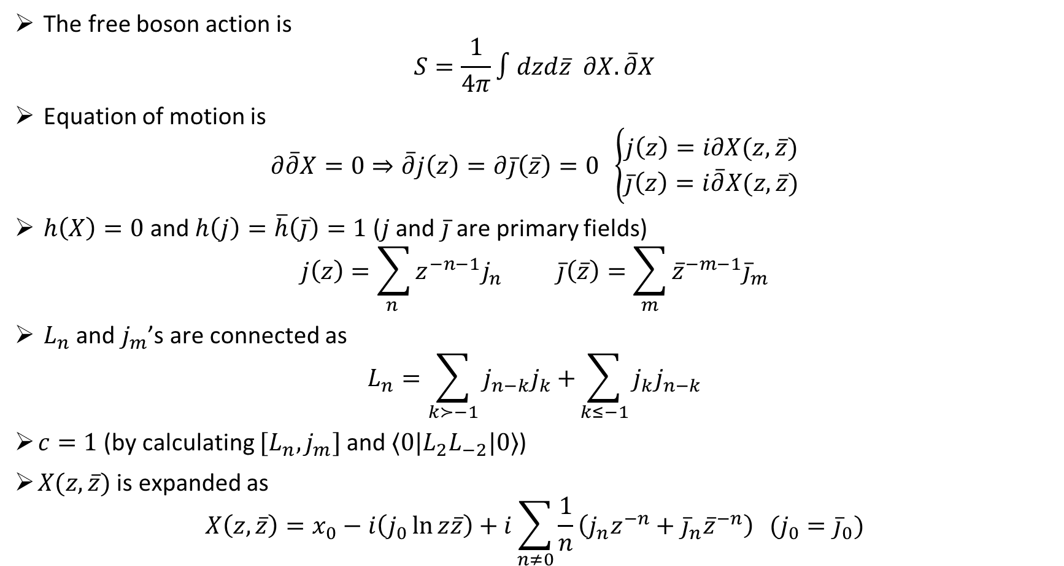

Free boson $X(z,\overline{z})$
The free boson action is
$$S=\frac{1}{4π}∫dzd\overline{z} ∂X.\overline{∂}X$$
Equation of motion is
$$∂\overline{∂}X=0⇒\overline{∂}j\left(z\right)=∂\overline{j}\left(\overline{z}\right)=0 \left\{\begin{aligned}j\left(z\right)=i∂X(z,\overline{z}) \\ \overline{j}\left(z\right)=i\overline{∂}X(z,\overline{z})\end{aligned}\right.$$
$h\left(X\right)=0$ and $h\left(j\right)=\overline{h}\left(\overline{j}\right)=1$ ($j$ and $\overline{j}$ are primary fields)
$$j\left(z\right)=\sum_{n }{z^{−n−1}j_{n}} \overline{j}\left(\overline{z}\right)=\sum_{m}{{\overline{z}}^{−m−1}{\overline{j}}_{m}}$$
${ L}_{n}$ and $j_{m}$’s are connected as
$$L_{n}=\sum_{k≻−1}{j_{n−k}j_{k}+}\sum_{k≤−1}{j_{k}j_{n−k}}$$
$c=1$ (by calculating $[L_{n},j_{m}]$ and $⟨0|L_{2}L_{−2}|0⟩$)
$X(z,\overline{z})$ is expanded as
$$X\left(z,\overline{z}\right)=x_{0}−i\left(j_{0}\ln{z\overline{z}}\right)+i\sum_{n≠0}{\frac{1}{n}\left(j_{n}z^{−n}+{\overline{j}}_{n}{\overline{z}}^{−n}\right)} (j_{0}={\overline{j}}_{0})$$

Slide 13
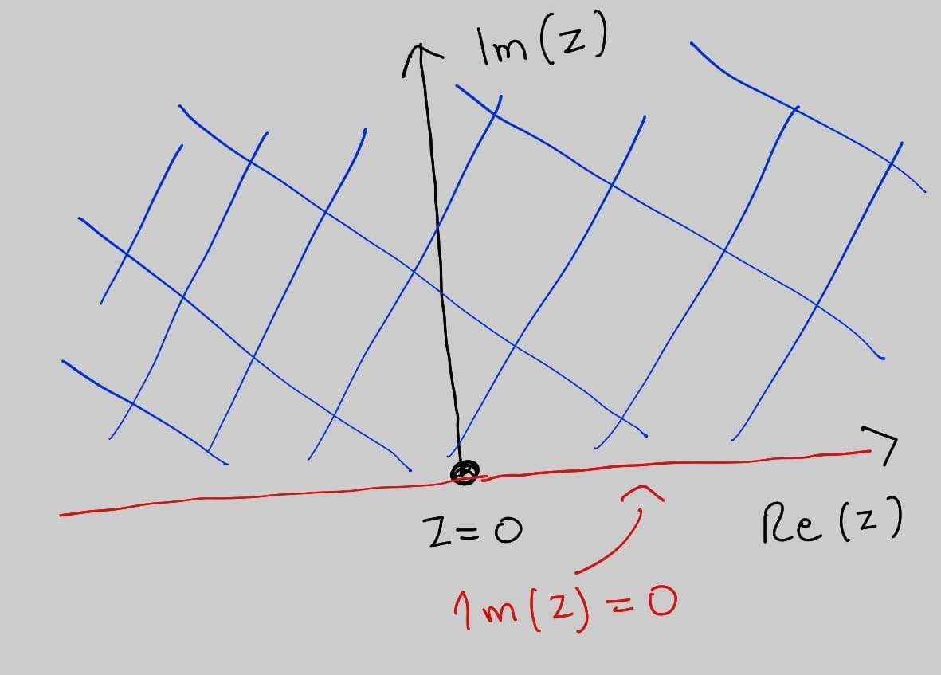
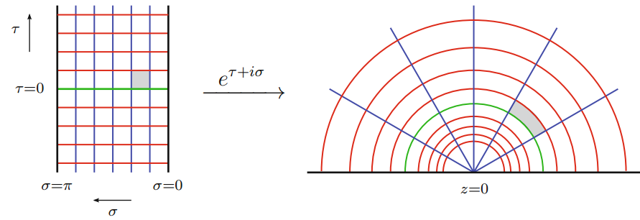
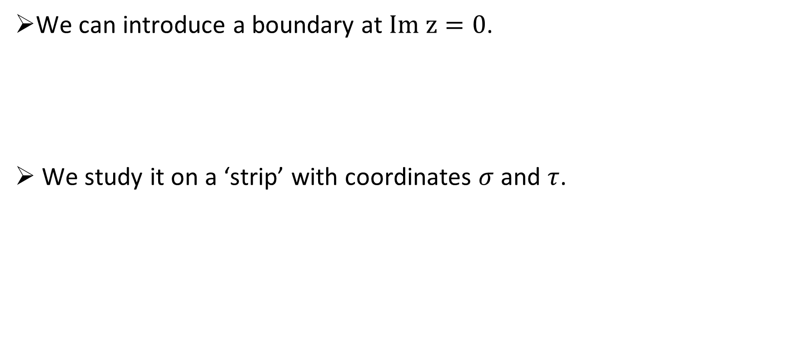
Introducing a boundary
We can introduce a boundary at $Im z=0$.
We study it on a ‘strip’ with coordinates $σ$ and $τ$.

Slide 14
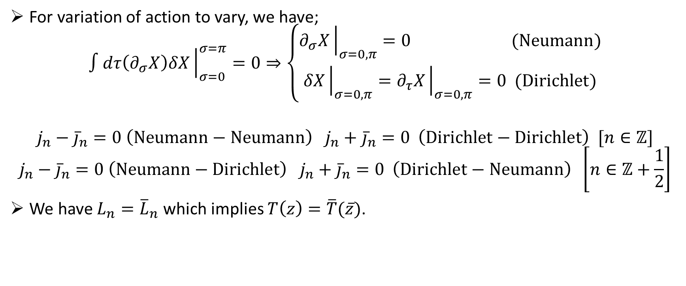
Free boson on the strip
For variation of action to vary, we have;
$$∫dτ\left(∂_{σ}X\right)δX{\left.​\right|}_{σ=0}^{σ=π}=0⇒\left\{\begin{aligned}∂_{σ}X{\left.​\right|}_{σ=0,π}=0 (Neumann) \\ δX{\left.​\right|}_{σ=0,π}=∂_{τ}X{\left.​\right|}_{σ=0,π}=0 (Dirichlet)\end{aligned}\right.$$
$$j_{n}−{\overline{j}}_{n}=0 \left(Neumann−Neumann\right) j_{n}+{\overline{j}}_{n}=0 \left(Dirichlet−Dirichlet\right) [n∈ℤ]$$
$$j_{n}−{\overline{j}}_{n}=0 \left(Neumann−Dirichlet\right) j_{n}+{\overline{j}}_{n}=0 \left(Dirichlet−Neumann\right) \left[n∈ℤ+\frac{1}{2}\right]$$
We have $L_{n}={\overline{L}}_{n}$ which implies $T\left(z\right)=\overline{T}(\overline{z})$.

Slide 15
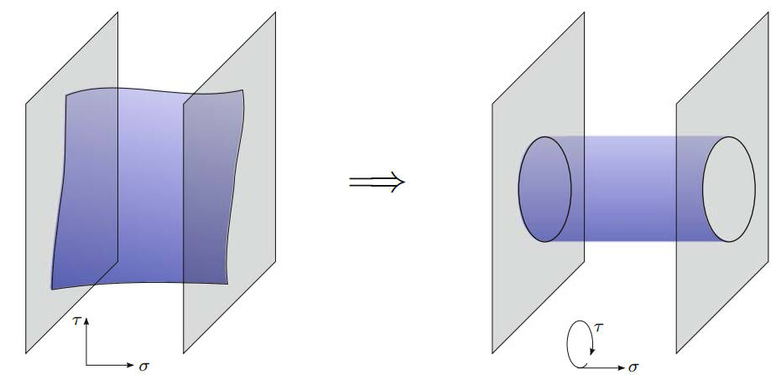
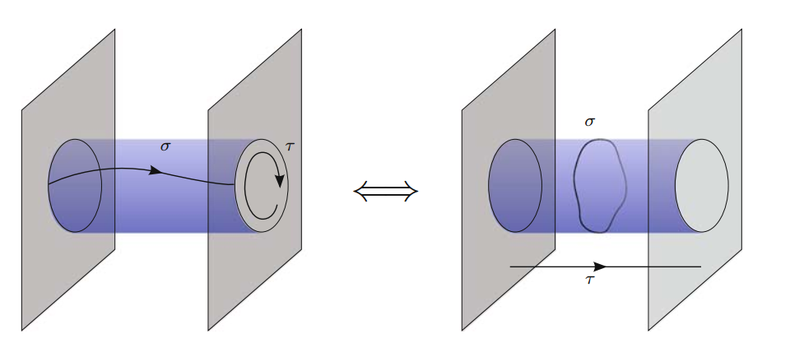
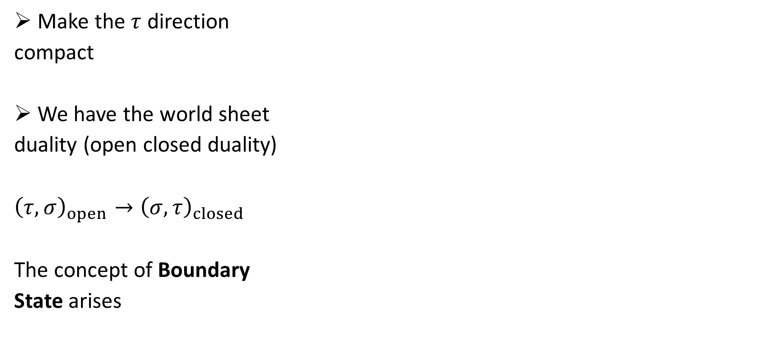
World Sheet duality
Make the $τ$ direction
compact
We have the world sheet
duality (open closed duality)
${\left(τ,σ\right)}_{open}→{\left(σ,τ\right)}_{closed}$
The concept of Boundary
State arises

Slide 16
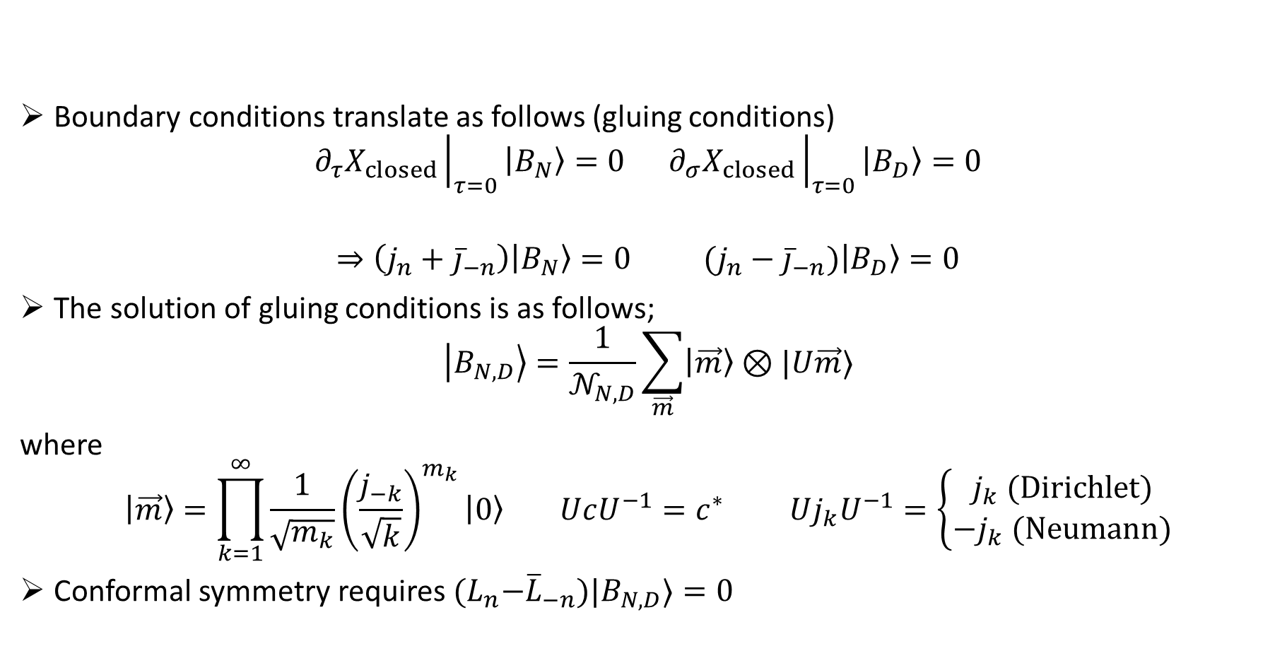
Boundary states
Boundary conditions translate as follows (gluing conditions)
$$∂_{τ}X_{closed}{\left.​\right|}_{τ=0}\left|B_{N}\right\rangle =0 ∂_{σ}X_{closed}{\left.​\right|}_{τ=0}\left|B_{D}\right\rangle =0$$
$$⇒\left(j_{n}+{\overline{j}}_{−n}\right)\left|B_{N}\right\rangle =0 (j_{n}−{\overline{j}}_{−n})\left|B_{D}\right\rangle =0$$
The solution of gluing conditions is as follows;
$$\left|B_{N,D}\right\rangle =\frac{1}{𝒩_{N,D}}\sum_{\vec{m}}{\left|\vec{m}\right\rangle ⊗|U\vec{m}⟩}$$
where
$$\left|\vec{m}\right\rangle =\prod_{k=1}^{∞}{\frac{1}{\sqrt{m_{k}}}{\left(\frac{j_{−k}}{\sqrt{k}}\right)}^{m_{k}}\left|0\right\rangle } UcU^{−1}=c^{∗} Uj_{k}U^{−1}=\left\{\begin{aligned}j_{k} (Dirichlet) \\ −j_{k} (Neumann)\end{aligned}\right.$$
Conformal symmetry requires ${(L}_{n}−{\overline{L}}_{−n})|B_{N,D}⟩=0$

Slide 17
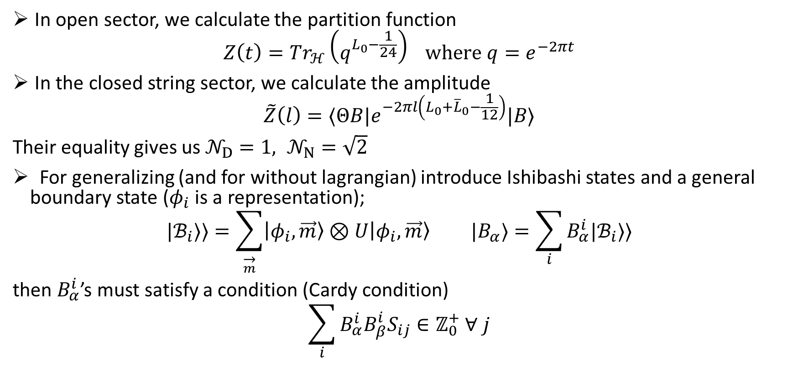
Constraint on Boundary States
In open sector, we calculate the partition function
$$Z\left(t\right)=Tr_{ℋ}\left(q^{L_{0}−\frac{1}{24}}\right) where q=e^{−2πt}$$
In the closed string sector, we calculate the amplitude
$$\tilde{Z}\left(l\right)=⟨ΘB|e^{−2πl\left(L_{0}+{\overline{L}}_{0}−\frac{1}{12}\right)}|B⟩$$
Their equality gives us $𝒩_{D}=1, 𝒩_{N}=\sqrt{2}$
For generalizing (and for without lagrangian) introduce Ishibashi states and a general boundary state ($φ_{i}$ is a representation);
$$|ℬ_{i}⟩⟩=\sum_{\overset{→}{m}}{\left|φ_{i},\vec{m}\right\rangle ⊗U\left|φ_{i},\vec{m}\right\rangle } |B_{α}⟩=\sum_{i}{B_{α}^{i}|ℬ_{i}⟩⟩}$$
then $B_{α}^{i}$’s must satisfy a condition (Cardy condition)
$$\sum_{i}{B_{α}^{i}B_{β}^{i}S_{ij}}∈ℤ_{0}^{+} ∀ j$$

Slide 18
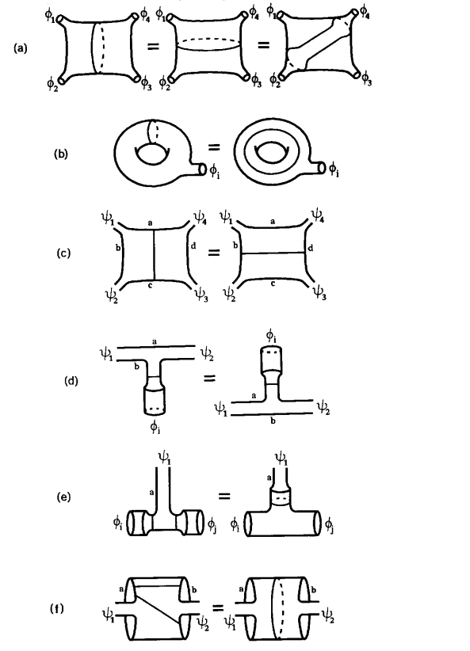
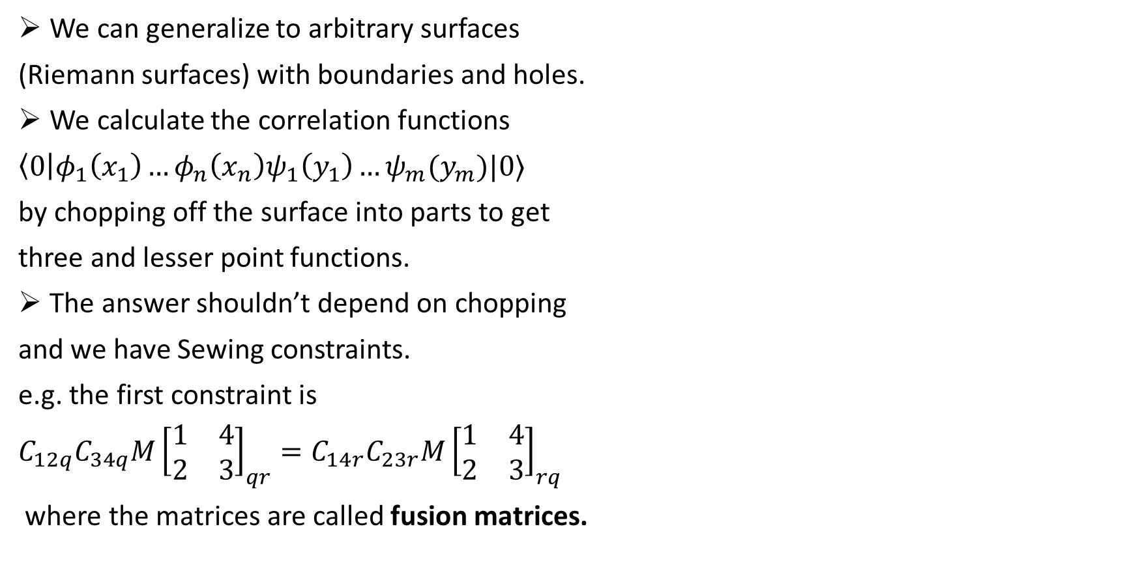
Sewing constraints
We can generalize to arbitrary surfaces
(Riemann surfaces) with boundaries and holes.
We calculate the correlation functions
$\left\langle 0\right|φ_{1}\left(x_{1}\right)…φ_{n}\left(x_{n}\right)ψ_{1}\left(y_{1}\right)…ψ_{m}(y_{m})|0⟩$
by chopping off the surface into parts to get
three and lesser point functions.
The answer shouldn’t depend on chopping
and we have Sewing constraints.
e.g. the first constraint is
$C_{12q}C_{34q}M{\left[\begin{matrix}1 & 4 \\ 2 & 3\end{matrix}\right]}_{qr}=C_{14r}C_{23r}M{\left[\begin{matrix}1 & 4 \\ 2 & 3\end{matrix}\right]}_{rq}$
where the matrices are called fusion matrices.

Slide 19
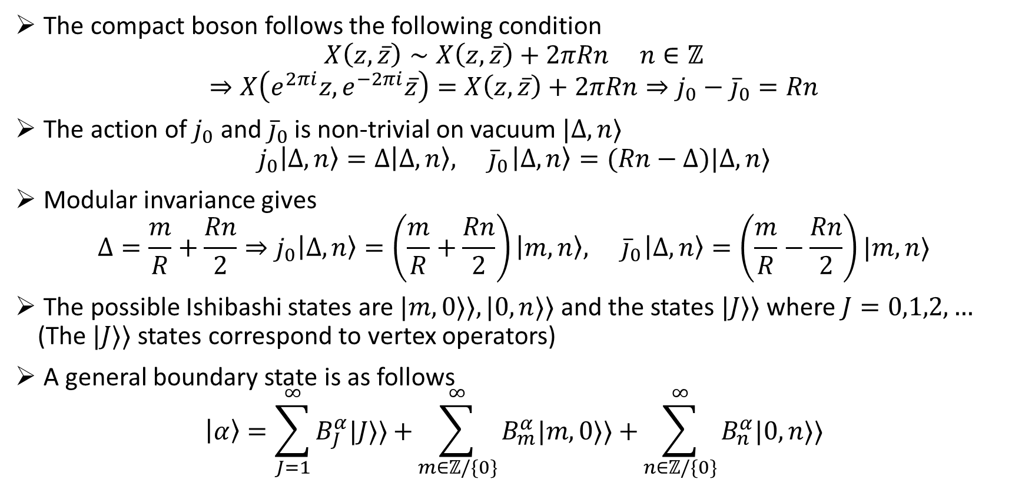
Free Compact Boson
The compact boson follows the following condition
$$X\left(z,\overline{z}\right)∼X\left(z,\overline{z}\right)+2πRn n∈ℤ$$
$$⇒X\left(e^{2πi}z,e^{−2πi}\overline{z}\right)=X\left(z,\overline{z}\right)+2πRn⇒j_{0}−{\overline{j}}_{0}=Rn$$
The action of $j_{0}$ and ${\overline{j}}_{0}$ is non-trivial on vacuum $|Δ,n⟩$
$$j_{0}\left|Δ,n\right\rangle =Δ\left|Δ,n\right\rangle ,{ \overline{j}}_{0}\left|Δ,n\right\rangle =(Rn−Δ)|Δ,n⟩$$
Modular invariance gives
$$Δ=\frac{m}{R}+\frac{Rn}{2}⇒j_{0}\left|Δ,n\right\rangle =\left(\frac{m}{R}+\frac{Rn}{2}\right)\left|m,n\right\rangle ,{ \overline{j}}_{0}\left|Δ,n\right\rangle =\left(\frac{m}{R}−\frac{Rn}{2}\right)|m,n⟩$$
The possible Ishibashi states are $|m,0⟩⟩,|0,n⟩⟩$ and the states $|J⟩⟩$ where $J=0,1,2,…$ (The $|J⟩⟩$ states correspond to vertex operators)
A general boundary state is as follows
$$\left|α\right\rangle =\sum_{J=1}^{∞}{B_{J}^{α}|J⟩⟩+}\sum_{m∈ℤ/\{0\}}^{∞}{B_{m}^{α}|m,0⟩⟩+}\sum_{n∈ℤ/\{0\}}^{∞}{B_{n}^{α}|0,n⟩⟩}$$

Slide 20
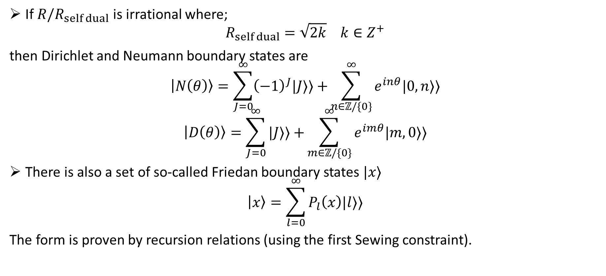
The irrational $\frac{R}{R_{self dual}}$ case
If $R/R_{self dual}$ is irrational where;
$$R_{self dual}=\sqrt{2k} k∈Z^{+}$$
then Dirichlet and Neumann boundary states are
$$\left|N\left(θ\right)\right\rangle =\sum_{J=0}^{∞}{{\left(−1\right)}^{J}|J⟩⟩+}\sum_{n∈ℤ/\{0\}}^{∞}{e^{inθ}|0,n⟩⟩}$$
$$\left|D\left(θ\right)\right\rangle =\sum_{J=0}^{∞}{|J⟩⟩+}\sum_{m∈ℤ/\{0\}}^{∞}{e^{imθ}|m,0⟩⟩}$$
There is also a set of so-called Friedan boundary states $|x⟩$
$$\left|x\right\rangle =\sum_{l=0}^{∞}{P_{l}\left(x\right)|l⟩⟩}$$
The form is proven by recursion relations (using the first Sewing constraint).

Slide 21
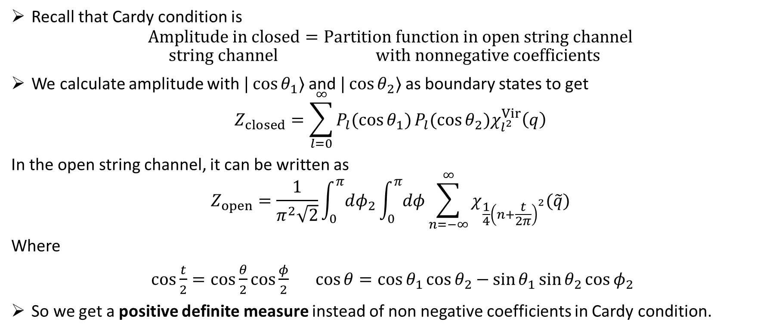

Analogue of Cardy condition in $\frac{R}{R_{self dual}}$ case
Recall that Cardy condition is
$$Amplitude in closed=Partition function in open string channel$$
$$string channel with nonnegative coefficients$$
We calculate amplitude with $|\cos{θ_{1}}⟩$ and $|\cos{θ_{2}}⟩$ as boundary states to get
$$Z_{closed}=\sum_{l=0}^{∞}{P_{l}(\cos{θ_{1})}P_{l}(\cos{θ_{2})χ_{l^{2}}^{Vir}\left(q\right)}}$$
In the open string channel, it can be written as
$$Z_{open}=\frac{1}{π^{2}\sqrt{2}}\int_{0}^{π}{dφ_{2}}\int_{0}^{π}{dφ}\sum_{n=−∞}^{∞}{χ_{\frac{1}{4}{\left(n+\frac{t}{2π}\right)}^{2}}(\tilde{q})}$$
Where
$\cos{\frac{t}{2}=\cos{\frac{θ}{2}\cos{\frac{φ}{2}}}} \cos{θ=\cos{θ_{1}}\cos{θ_{2}−}\sin{θ_{1}}\sin{θ_{2}\cos{φ_{2}}}}$
So we get a positive definite measure instead of non negative coefficients in Cardy condition.

Slide 22
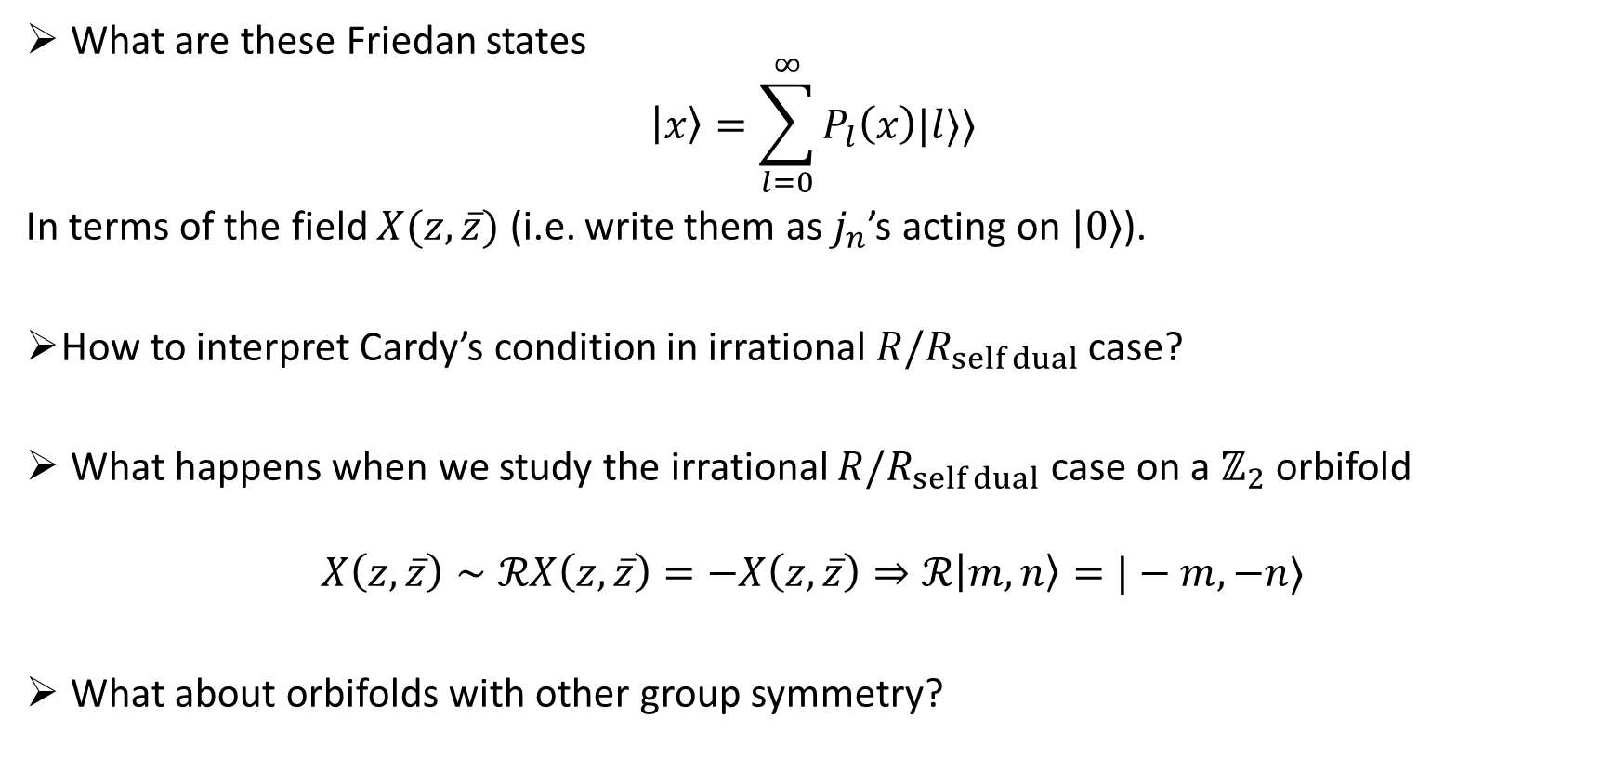
Questions
What are these Friedan states
$$\left|x\right\rangle =\sum_{l=0}^{∞}{P_{l}\left(x\right)|l⟩⟩}$$
In terms of the field $X(z,\overline{z})$ (i.e. write them as $j_{n}$’s acting on $|0⟩$).
How to interpret Cardy’s condition in irrational$R/R_{self dual}$ case?
What happens when we study the irrational $R/R_{self dual}$ case on a $ℤ_{2}$ orbifold
$$X\left(z,\overline{z}\right)∼ℛX\left(z,\overline{z}\right)=−X\left(z,\overline{z}\right)⇒ℛ\left|m,n\right\rangle =|−m,−n⟩$$
What about orbifolds with other group symmetry?

Slide 23
Thank you
for listening

